Slide 1


UAS Mongo x Express API
Praktikum Basis Data Lanjut

Slide 2
Kelas
2 D4 IT A

Slide 3
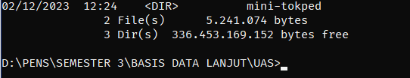
MEMBUAT FOLDER KOSONG
SCRIPT:
mkdir mini-tokped

Slide 4

INIT EXPRESS.JS
SCRIPT:
npm init -y

Slide 5
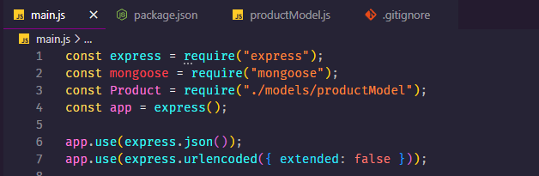
MEMBUAT MAIN.JS
SCRIPT:

Slide 6
MENAMBAHKAN KODE UNTUK ROUTER #1
READ BY ID:
app.get("/products/:id", async (req, res) => {
try {
const { id } = req.params;
const product = await Product.findById(id);
res.status(200).json(product);
} catch (error) {
res.status(500).json({ message: error.message });
}
});
READ ALL:
app.get("/products", async (req, res) => {
try {
const products = await Product.find({});
res.status(200).json(products);
} catch (error) {
res.status(500).json({ message: error.message });
}
});

Slide 7
MENAMBAHKAN KODE UNTUK ROUTER #2
CREATE:
app.post("/products", async (req, res) => {
try {
const product = await Product.create(req.body);
res.status(200).json(product);
} catch (error) {
console.log(error.message);
res.status(500).json({ message: error.message });
}
});
UPDATE BY ID:
app.put("/products/:id", async (req, res) => {
try {
const { id } = req.params;
const product = await Product.findByIdAndUpdate(id, req.body);
// we cannot find any product in database
if (!product) {
return res
.status(404)
.json({ message: `cannot find any product with ID ${id}` });
}
const updatedProduct = await Product.findById(id);
res.status(200).json(updatedProduct);
} catch (error) {
res.status(500).json({ message: error.message });
}
});

Slide 8
MENAMBAHKAN KODE UNTUK ROUTER #3
DELETE BY ID:
app.delete("/products/:id", async (req, res) => {
try {
const { id } = req.params;
const product = await Product.findByIdAndDelete(id);
if (!product) {
return res
.status(404)
.json({ message: `cannot find any product with ID ${id}` });
}
res.status(200).json(product);
} catch (error) {
res.status(500).json({ message: error.message });
}
});

Slide 9
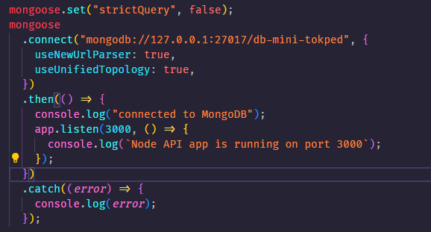
KONEKSI KE MONGO
SCRIPT:
mongoose.set("strictQuery", false);
mongoose
.connect("mongodb://127.0.0.1:27017/db-mini-tokped", {
useNewUrlParser: true,
useUnifiedTopology: true,
})
.then(() => {
console.log("connected to MongoDB");
app.listen(3000, () => {
console.log(`Node API app is running on port 3000`);
});
})
.catch((error) => {
console.log(error);
});

Slide 10
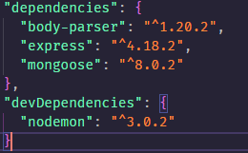
INSTALL DEPENDENCIES
SCRIPT:
npm i nodemon
npm i nodemon
npm i mongoose

Slide 11
MEMBUAT DATABASE DI MONGO
SCRIPT:

Slide 12
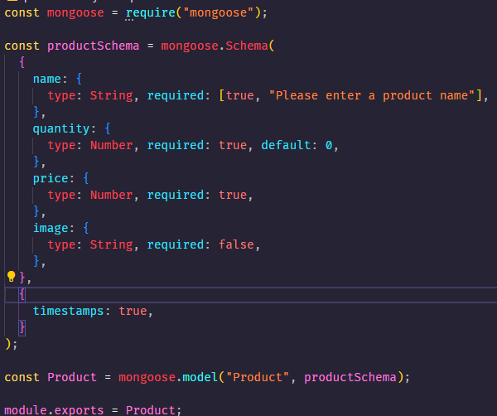
MEMBUAT SCHEMA COLLECTION
SCRIPT:
const mongoose = require("mongoose");
const productSchema = mongoose.Schema(
{
name: {
type: String, required: [true, "Please enter a product name"],
},
quantity: {
type: Number, required: true, default: 0,
},
price: {
type: Number, required: true,
},
image: {
type: String, required: false,
},
},
{
timestamps: true,
}
);
const Product = mongoose.model("Product", productSchema);
module.exports = Product;

Slide 13
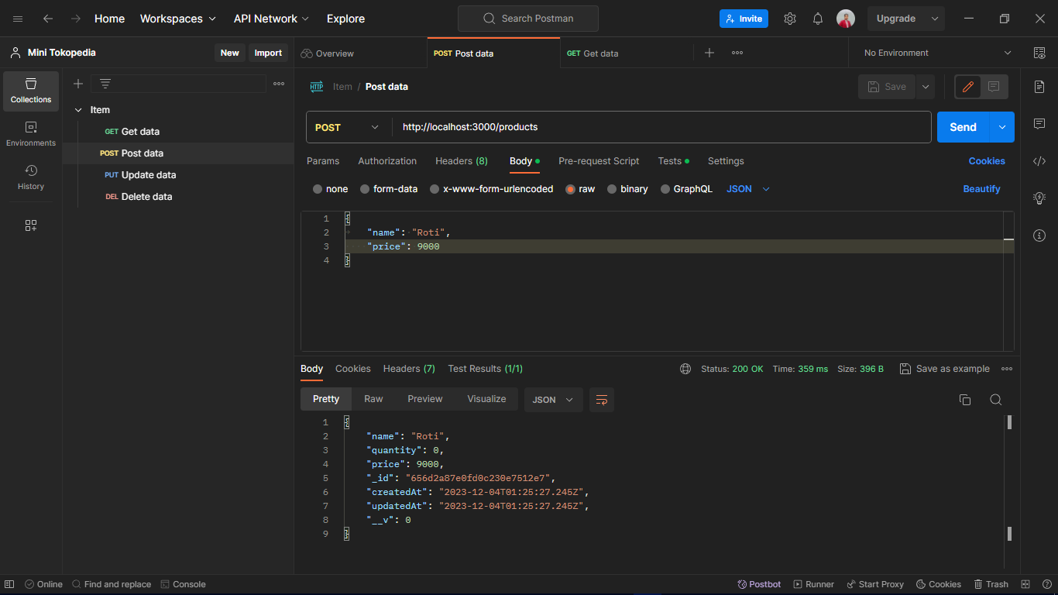
TEST POSTMAN | CREATE DATA

Slide 14
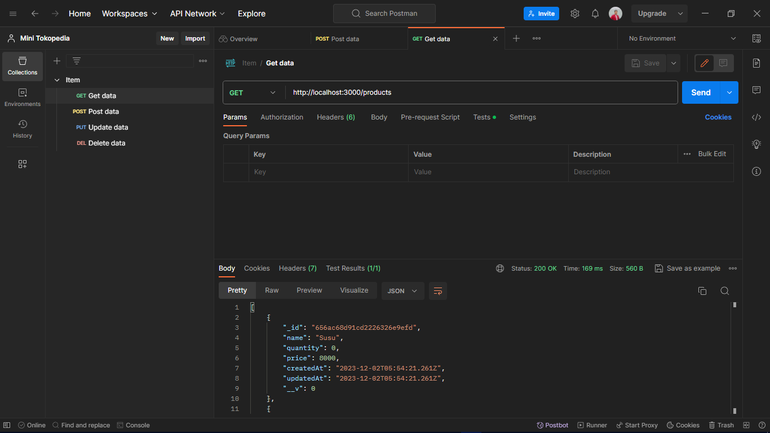
TEST POSTMAN | READ ALL DATA

Slide 15
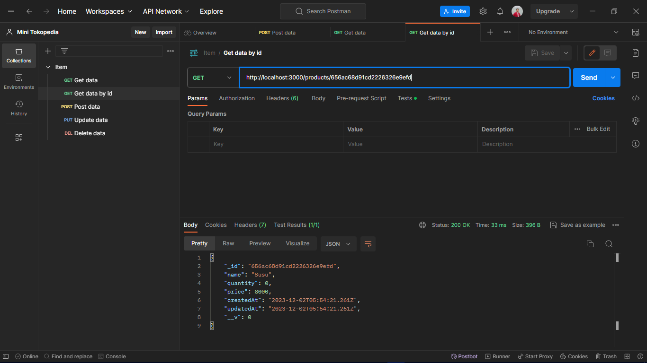
TEST POSTMAN | READ DATA BY ID

Slide 16
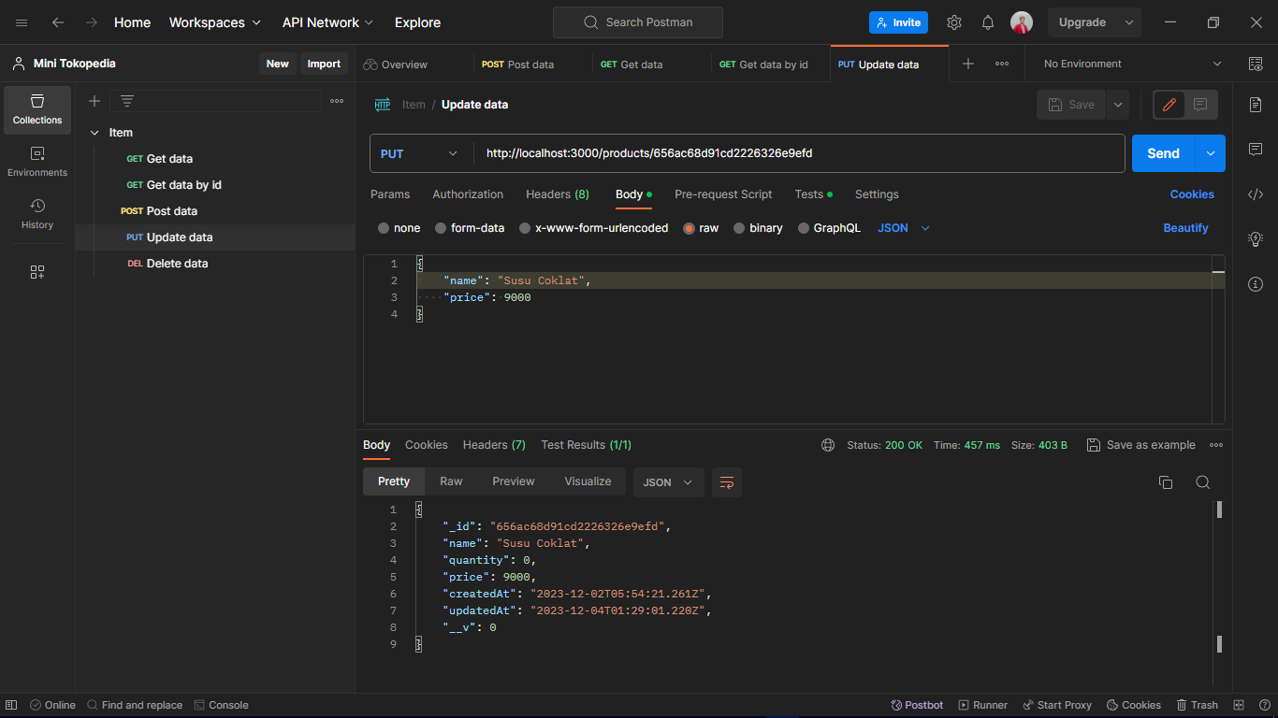
TEST POSTMAN | UPDATE DATA BY ID

Slide 17
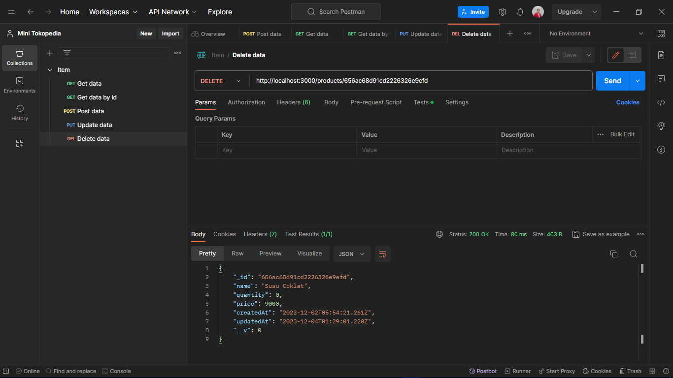
TEST POSTMAN | DELETE DATA BY ID

Slide 18
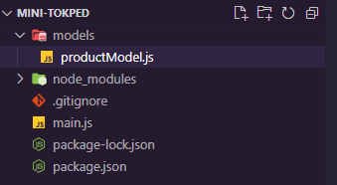
STRUKTUR PROJEK EXPRESS

Slide 19
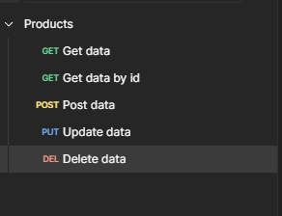
STRUKTUR TES API POSTMAN

Slide 20
Terimakasih
Sekian

